Slide 1







job
PORTFOLIO
enter_slogan
name 입니다
WORK
CONTACT
email
start_year-end_year

Slide 2
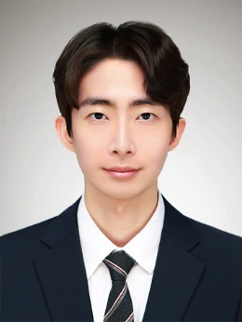
CERTIFICATION
EDUCATION
certificate_date | certificate_name | certificate_authority
entrance_date-graduate_date | education_name | major(type)
LANGUAGE SKILLS
GRADE
language_date | language_name | language_grade
총평점평균 | 전공평점평균
total_grade/4.5 | major_grade/4.5
TECH STACK 〮 SKILL
AWARD
NAME
name
stack_name | stack_level
award_date | award_name | award_authority
E-MAIL
email
PHONE
phone_number
ACTIVITIES
activity_name | activity_details
URI
GitHub
github_url
Blog
https://blog_url
EXPERIENCES
experience_start_date-experience_end_date | experience_name | experience_role

Slide 3


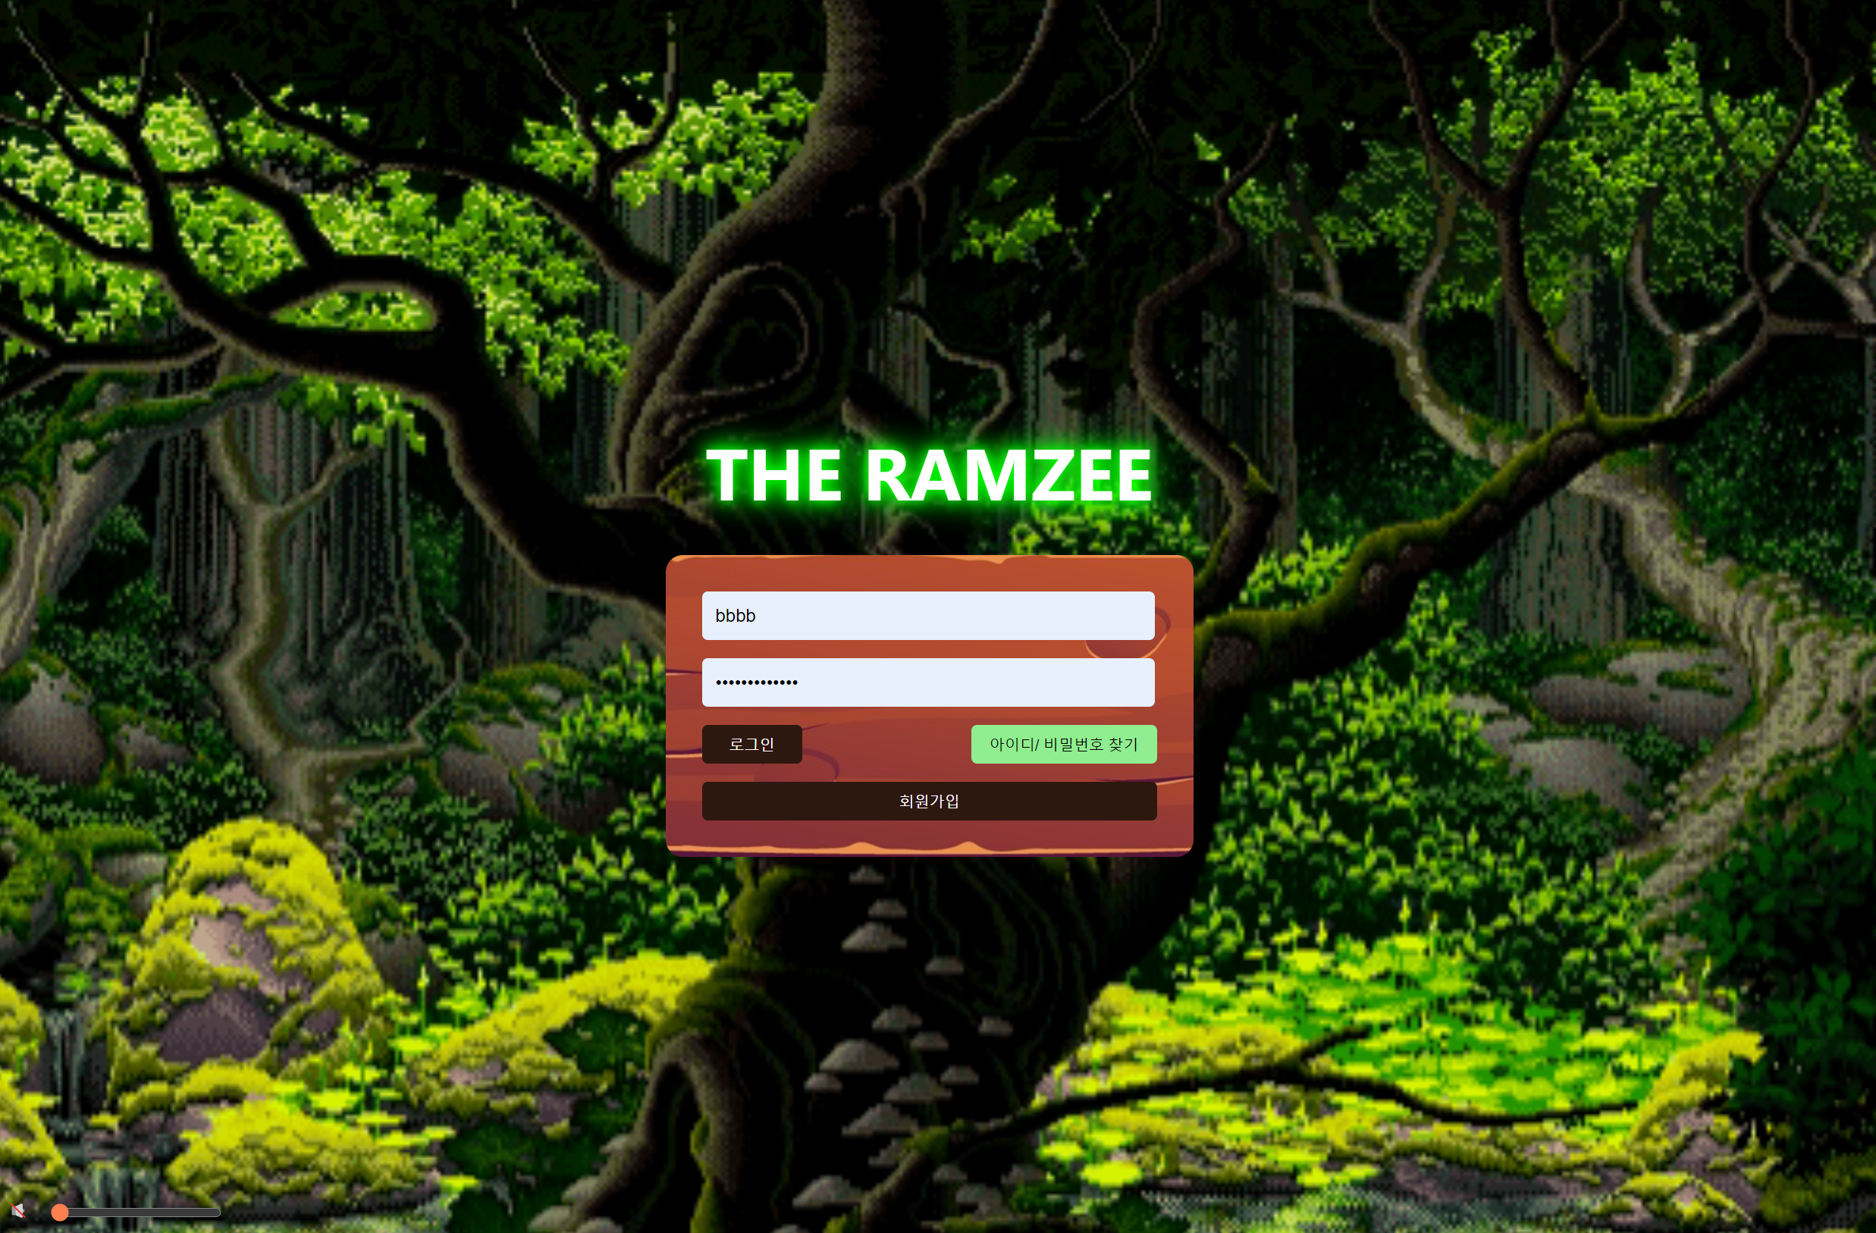
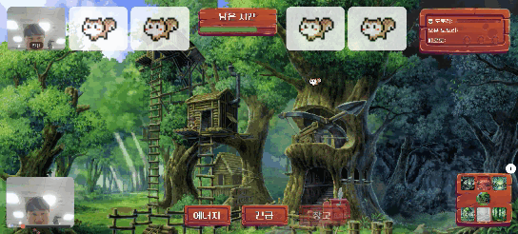
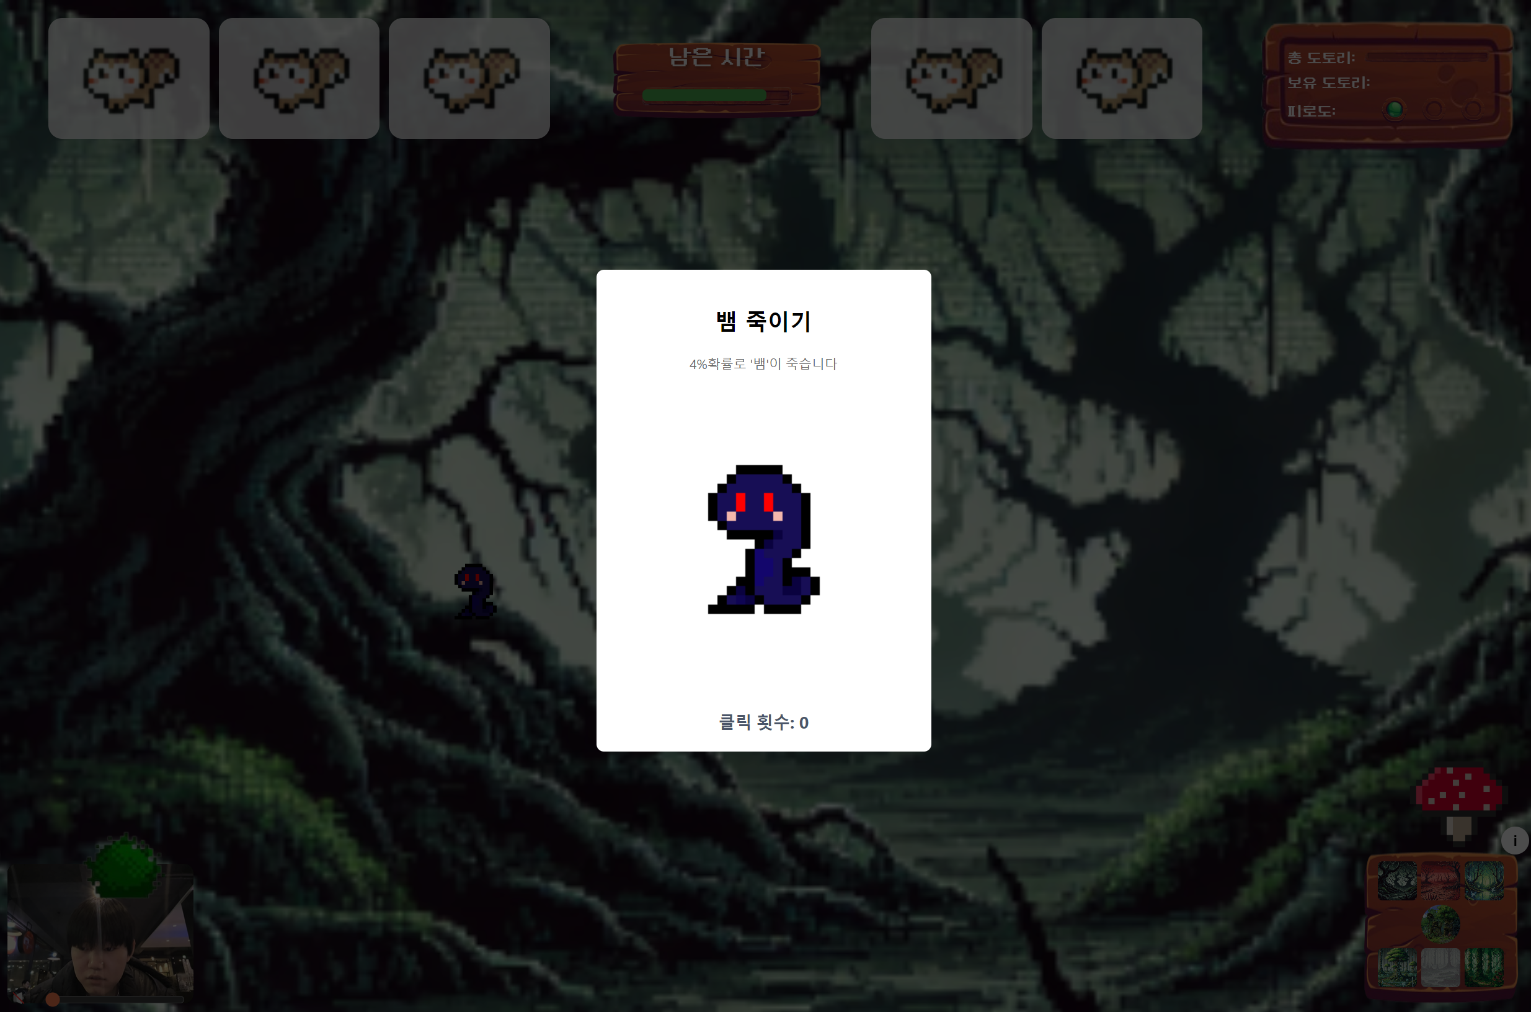
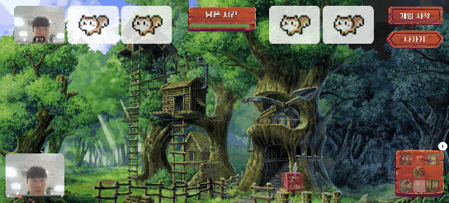
PROJECT No. 1
PROJECT
project_name
year
MEMBER | 인원
Frontend | 2명
Backend | 3명
Infra | 1명
Role | 역할
user_roles
DURATION | 기간
project_start_date – project_end_date
AWARD | 수상
project_award
DESCRIPTION | 설명
project_description
GITHUB | 주소
https://github.com/repo_name/

Slide 4
PROJECT | project_name
TROUBLESHOOTING | 트러블 슈팅 〮 문제 해결
TECH STACK | 기술 스택
tech_domain | tech_name
PROBLEM | 문제 | DETAIL | 상세 | SOLVE | 해결
troubleshooting_name | troubleshooting_detail | troubleshooting_solve
Contributions | 기여 〮 공헌
project_contributions

Slide 5




final_slogan
name
email
phone_number

